Slide 1
ASYNCHRONOUS JAVASCRIPT

Slide 2
PLAN
Async in JS
Promises
Promise magic
Async/Await
Events & Callbacks
Promise overview
.then(), .catch(), parallel execution
Write async code as sync!

Slide 3
ASYNC IN JS

Slide 4
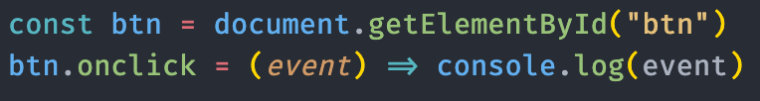
EVENTS
The most basic form of asynchronous programming in JavaScript.

Slide 5
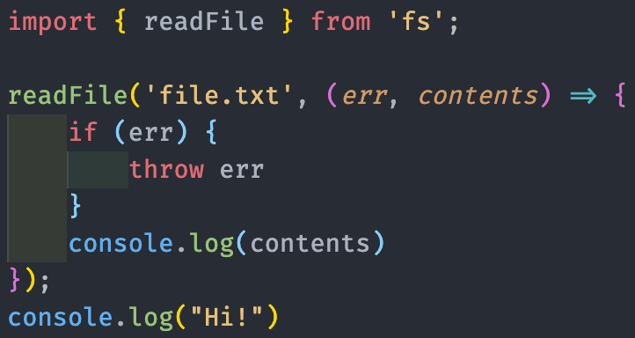
CALLBACKS: BASIC
Functions that are called after an asynchronous operation
Usually are passed as arguments.

Slide 6
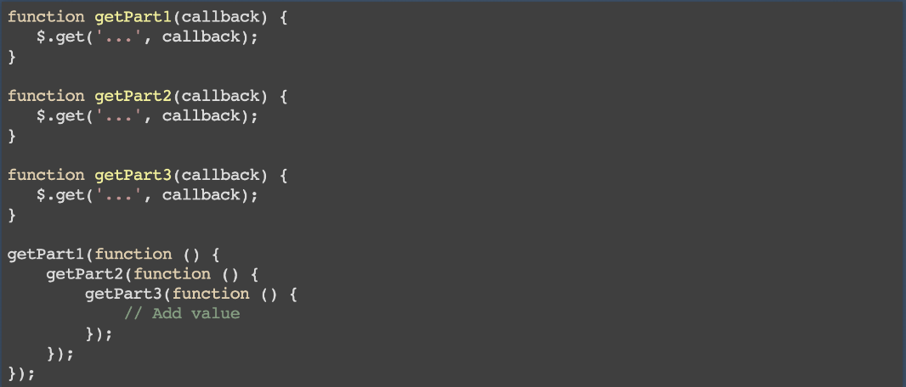
CALLBACKS: HARD

Slide 7
CALLBACKS: HELL

Slide 8
PROMISES

Slide 9
PROMISES
Operation that will return its result some time later
Multiple handlers of one result
Complex compositions of asynchronous operations
Easier to handle errors
You can "recover" from an error

Slide 10
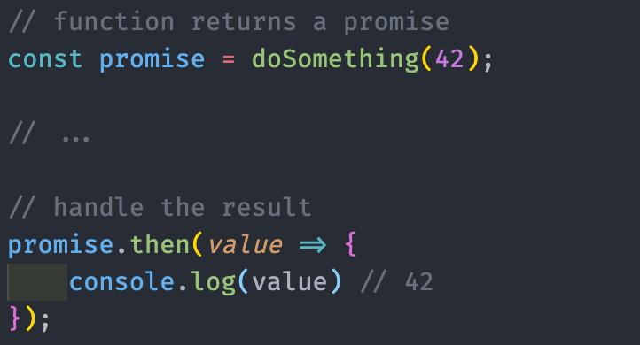
.THEN

Slide 11
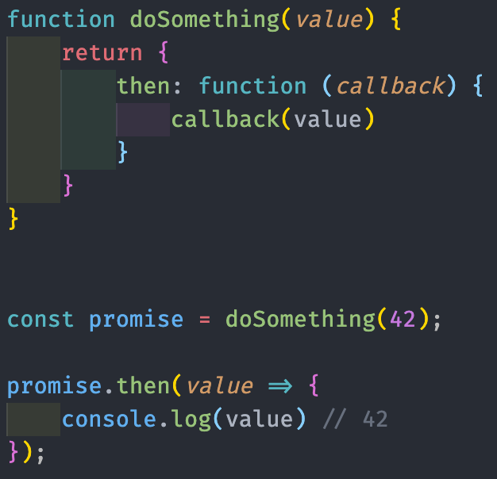
PROMISES & THENABLES
Promises are objects whose behaviour conforms to the Promise / A + specification
Thenables - objects that have the .then method.

Slide 12
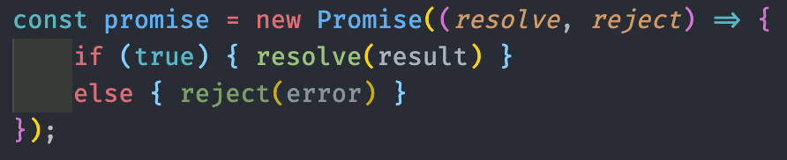
CONSTRUCTOR
The function passed to new Promise() is called the executor.
.then () and resolve () are called independently.

Slide 13
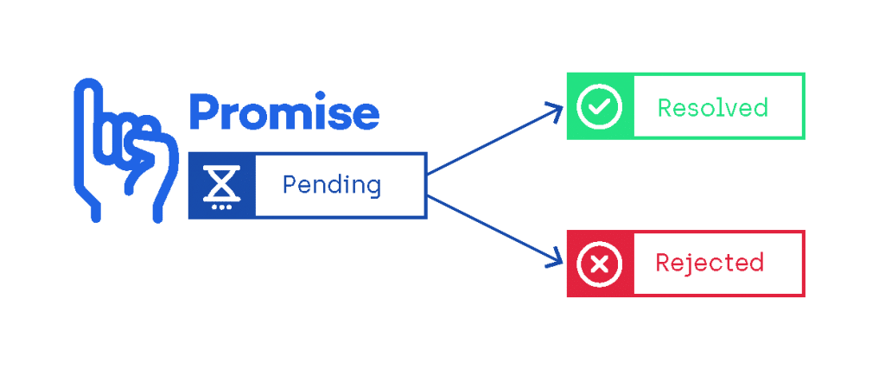
PROMISE STATES
A Promise is in one of three states:
pending: initial state, neither fulfilled nor rejected.
fulfilled: meaning that the operation completed successfully.
rejected: meaning that the operation failed.

Slide 14
WORKING WITH PROMISES

Slide 15
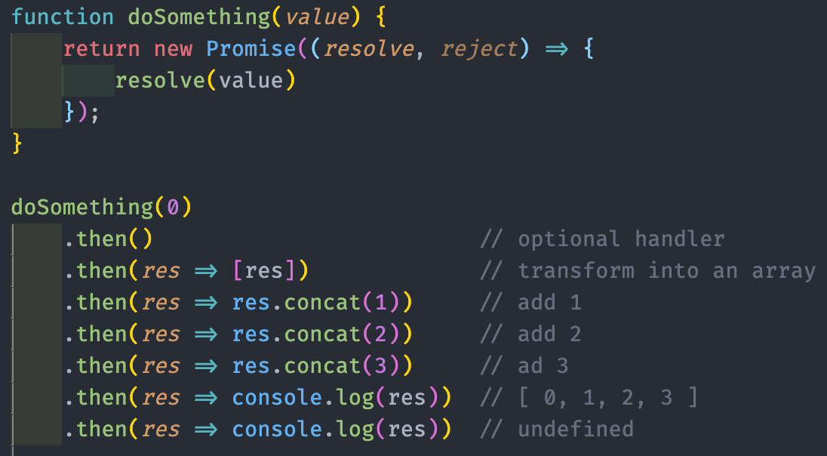
.THEN() MAGIC
.then() always returns a new promise
This new promise is resolved when the previous one was either completed or rejected.
.then() may not have a handler
The result is transferred to the next promise
If you return a value from the handler in .then(), it will be the value of the next promise
You can transfer data from one promise to the next

Slide 16
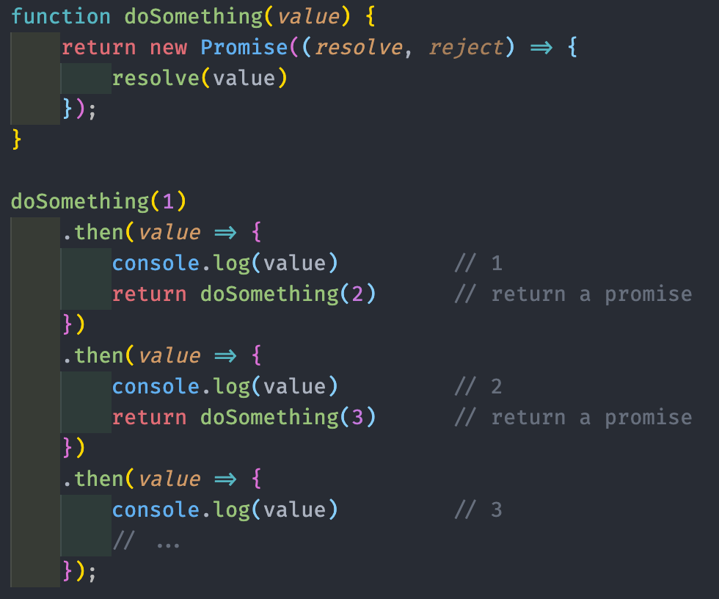
.THEN() & NEW PROMISE
If you return a promise with .then (), it will be resolved
The result will be wrapped in a new promise and will be available in the next .then()

Slide 17
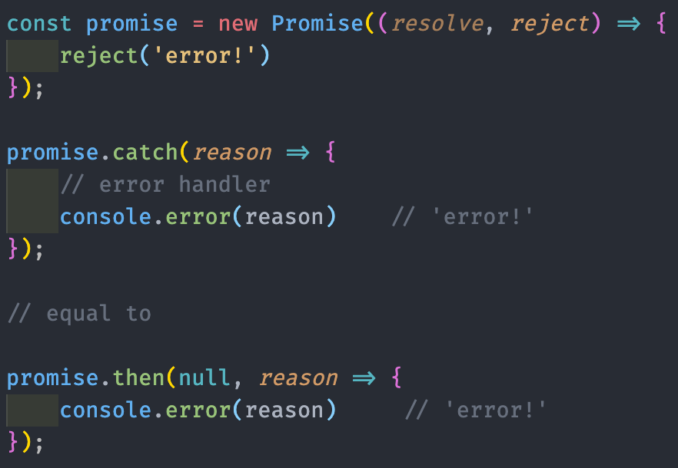
ERROR HANDLING
Promises can be rejected with reason
As a second argument, the executor receives a function that rejects the promise
.then() can receive an error handler as the second argument
Both the completion handler and error handler are optional.
.catch() only accepts an error handler
.catch() is similar to .then() without a completion handler.

Slide 18
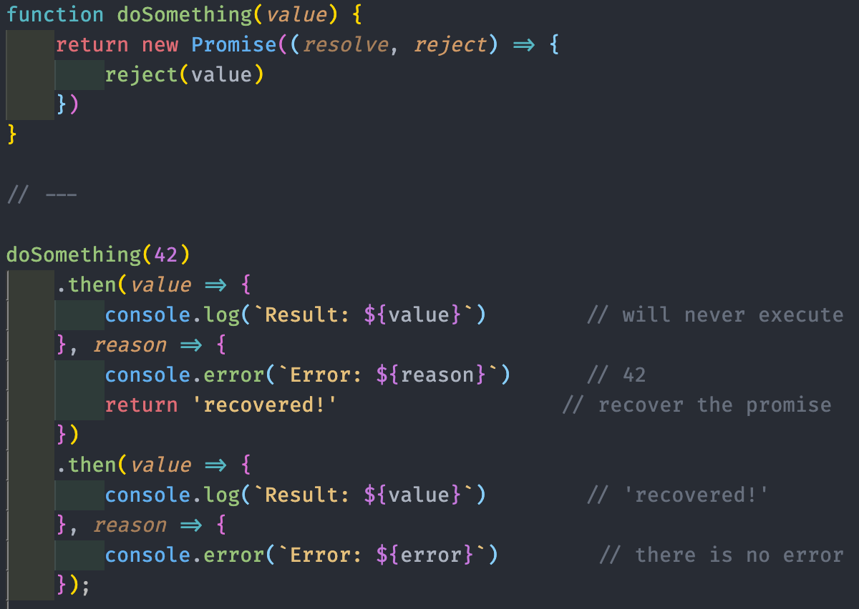
RECOVERY
Promises are able to "recover"
If you return a value from the error handler, it will go to the completion handler of the next promise.

Slide 19
FAIL SILENTLY
If an error occurs in a promise that does not have an error handler, the promise will "keep quiet" about the error.

Slide 20
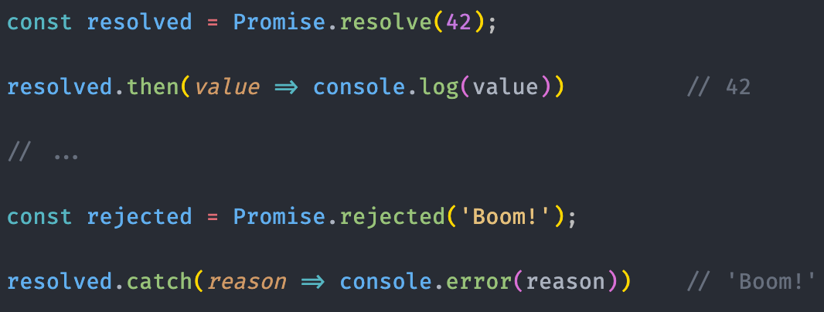

CREATING COMPLETED PROMISES
Promise.resolve () and Promise.reject () allow you to create a completed promise
They can take primitives as an argument and wrap them in a promise.

Slide 21
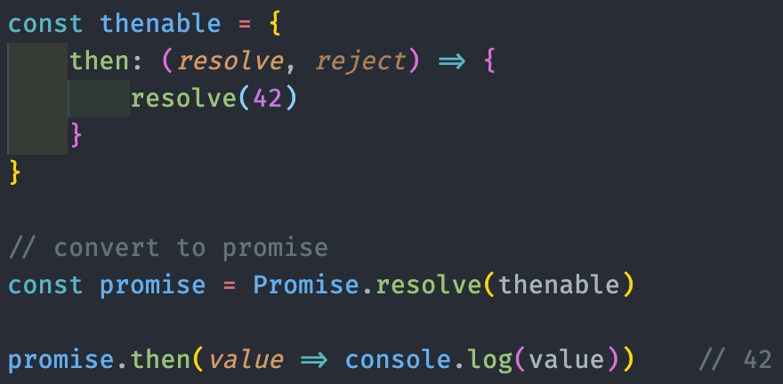
BACK TO THENABLES
Promise.resolve () and Promise.reject () can take thenable arguments
They can turn thenables into real promises.

Slide 22
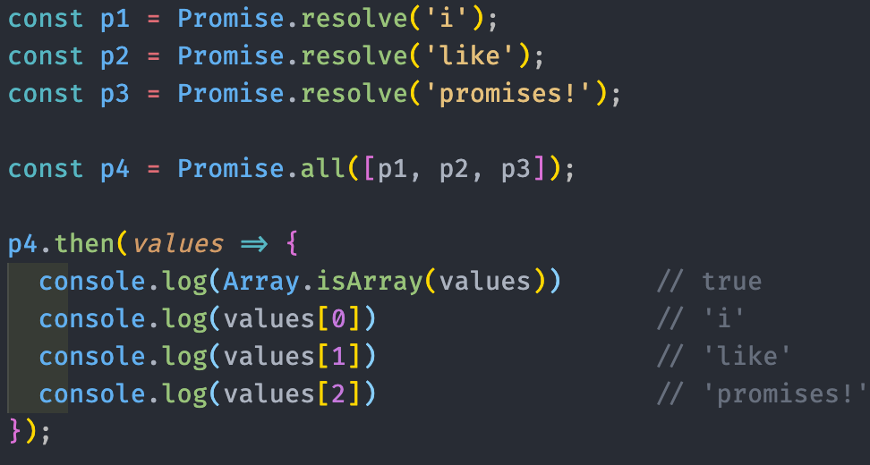
PARALLEL EXECUTION: ALL
Promise.all() is waits for all promises to complete
Returns a new promise, which resolves when all promises are completed.

Slide 23
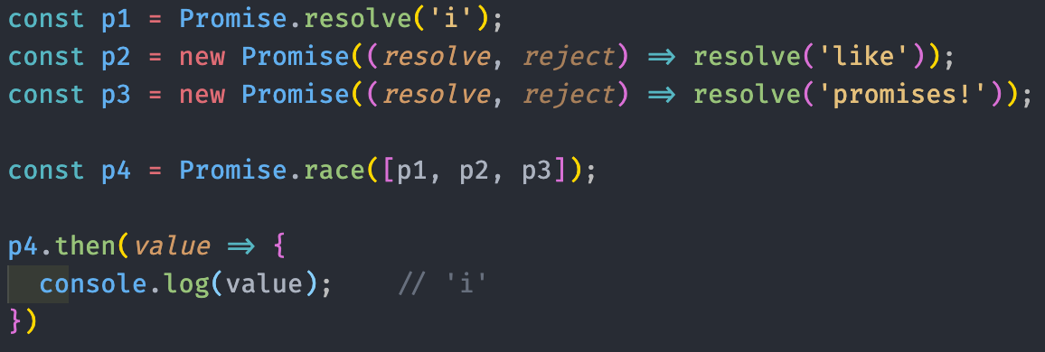
PARALLEL EXECUTION: RACE
Promise.race () creates a race among promises
Returns a new promise, which completes when the fastest promise ends.

Slide 24

ASYNC/AWAIT

Slide 25
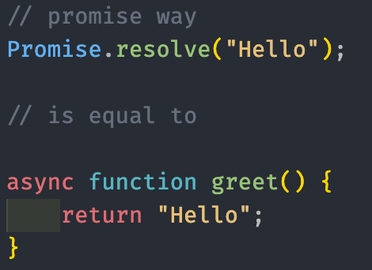
ASYNC/AWAIT
ES7 introduced a new way to add async behaviour in JavaScript
Working with promises became easier
New async and await keywords
async functions will implicitly return a promise.
Don’t have to create new promises yourself.

Slide 26
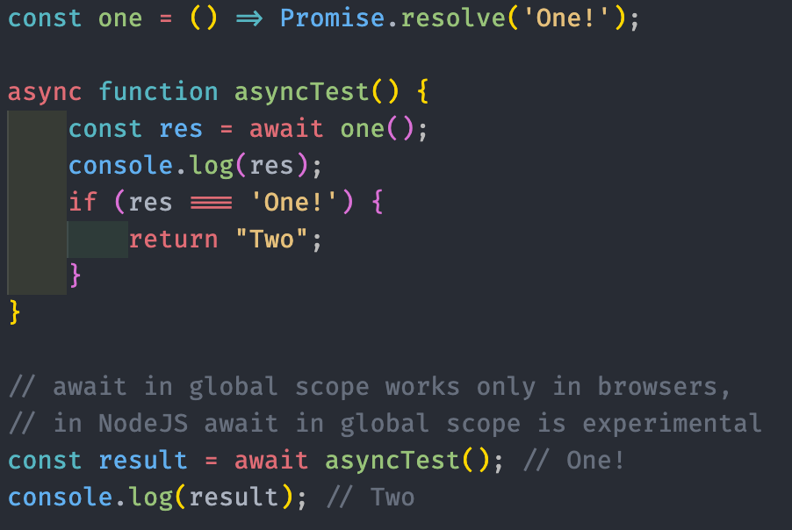
SUSPEND EXECUTION
await keyword suspends the asynchronous function and waits for the awaited value return a resolved promise
To get the value of this resolved promise just assign variables to the awaited promise value!
Like we previously did with the then() callback
await doesn’t work in global scope in NodeJS

Slide 27
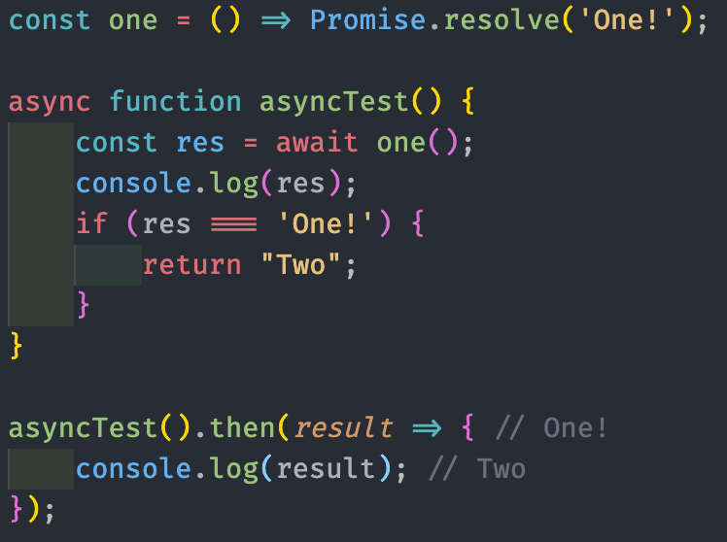
ADD SUGAR
Async/Await is just syntactic sugar for promises, so you can treat async function like promises

Slide 28
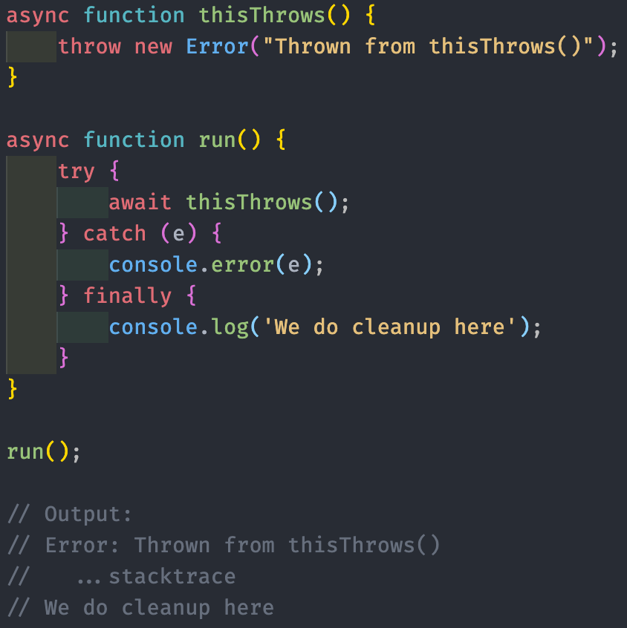
ERROR HANDLING
Async/await allow us to handle errors the same way we do with synchronous code with try…catch

